Slide 1

High Strain Rate Forming of Sub-Scale Parts
via Vaporizing Foil Actuator (VFA)
Michael Dunkley
Advisor: Prof. Kinsey
Graduate Seminar Presentation
April 20, 2018

Slide 2

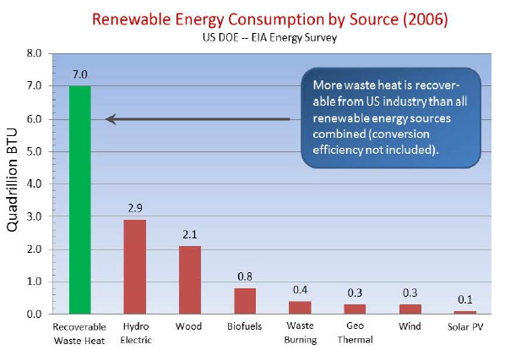
Background
Large opportunity to recover waste heat from US industry
https://www.energy.gov/sites/prod/files/2006/Waste%20Heat%20Recovery%20TA%20Feb-13-2006.pdf
*One quadrillion BTUs, or ‘Quad’, is 8,000,000,000 gallons of gasoline

Slide 3
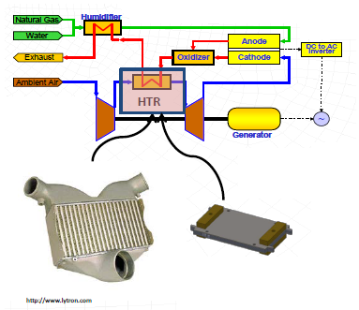

Background
B. Paul, et al., Oregon State University, 2017
Proposed Advantages:
Smaller
Lighter
Lower Cost
Less Raw Materials
High Temperature Recuperator
High Temperature Microchannel Recuperator

Slide 4
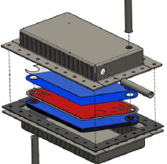
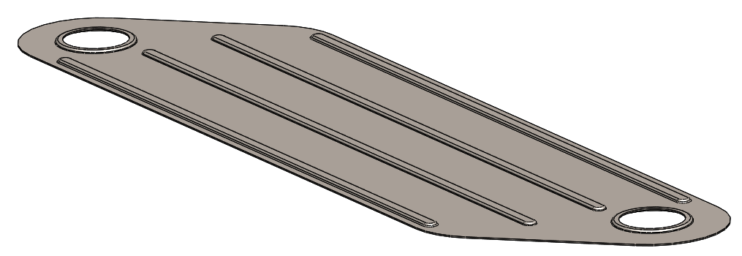
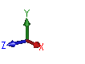
Background
*Designed by OSU
High Temperature Microchannel Recuperator:
25x10x13cm
Lamina Insert
B. Paul, et al., Oregon State University, 2017

Slide 5
Background
Lamina Insert:
0.5mm thick
50mm wide
178mm long
+/-5% tolerance on height feature, i.e., +/- 0.025mm
Traditional fabrication methods:
Photochemical Machining
Diffusion Brazing
Drawbacks:
Expensive
Over 50% of material is wasted
Unsure if traditional forming can achieve required tolerance and be a low cost solution

Slide 6
Presentation Outline
Background
Motivation/Goals
Numerical Investigation
Experimental Studies
Future Work

Slide 7
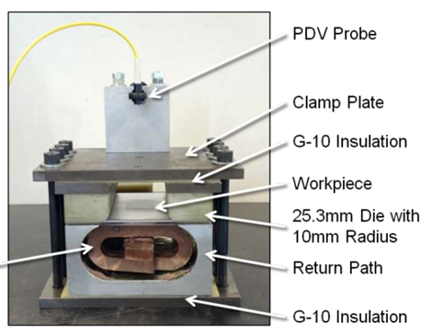
Motivation
High Strain Rate Forming:
Fast, Inexpensive, Repeatable
High strain rate forming increase forming limits of material
Two possible methods, electromagnetic forming (EMF, currently in MMM lab) and Vaporizing Foil Actuator (VFA)
Disadvantages of EMF:
Actuators tend to fail after repeated use
when magnetic pressures are increased
Only efficient with workpieces that are
electrically conductive
Limited velocity achievable
EMF can reach 300-400m/s
Where VFA can reach 800-900m/s
Applications:
Material forming, cutting and welding of dissimilar metals

Slide 8
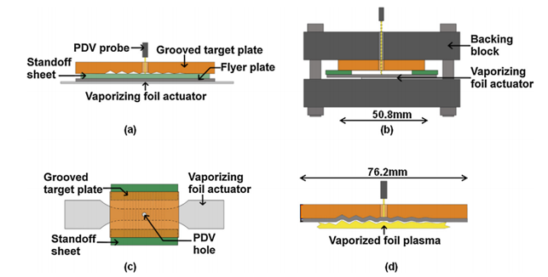
Vaporizer Foil Actuator Process Overview
From Ohio State University
A. Vivek, et al., Journal of Materials Processing Technology, 2013

Slide 9
Goals
Use Finite Element Analysis to direct design of lamina, e.g., bending radii, forming depth and gap between punch and die
Implement VFA forming in MMM lab

Slide 10
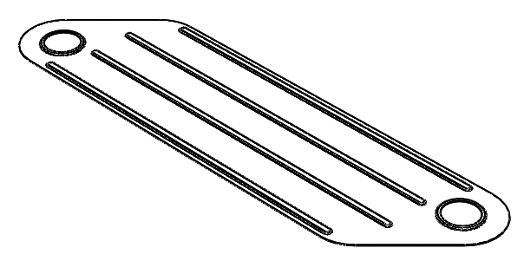
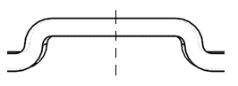
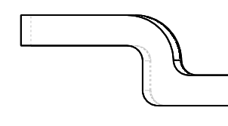
Numerical Approach
Lamina design provided by OSU
Rib
Emboss
Plane strain
Axisymmetric
Symmetry around center line to simplify model
Initial Bend Radii: 0.125mm; Modified Bend Radii: 0.25mm
Initial Forming Depth: 0.5mm; Modified Forming Depth: 0.2mm
Initial Gap: 1.1 x thickness; Modified Gap: 1 x thickness

Slide 11
Failure Modes
Necking/Rupture
Material failure due to excessive strains in forming
Springback
Could lead to unacceptable variance in tolerance
Wrinkling
Waviness experienced in full 3D part but not captured in our 2D model

Slide 12
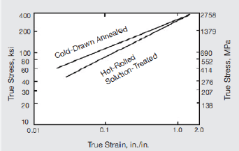
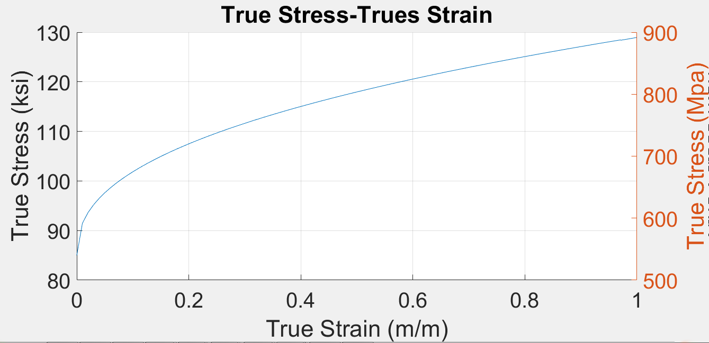
Material Properties
Inconel 625 * withstand corrosion and creep at high temperatures
Special Metals, ‘INCONEL Alloy 625’, specialmetals.com
Yield Strength: 586 MPa (85 ksi) at room temperature
Density: 8.44e-6 Kg/cu-mm (0.305 lb/cu-in )
Modulus of Elasticity: 207.5 GPa (30100 ksi )
Poisson’s Ratio: 0.278
Will receive Inconel 625 for material characterization

Slide 13
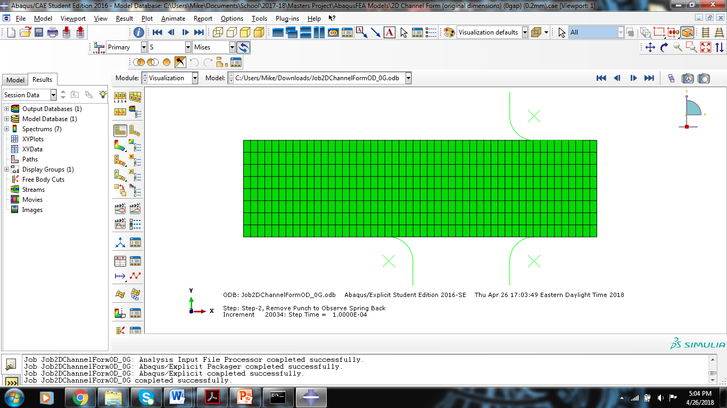
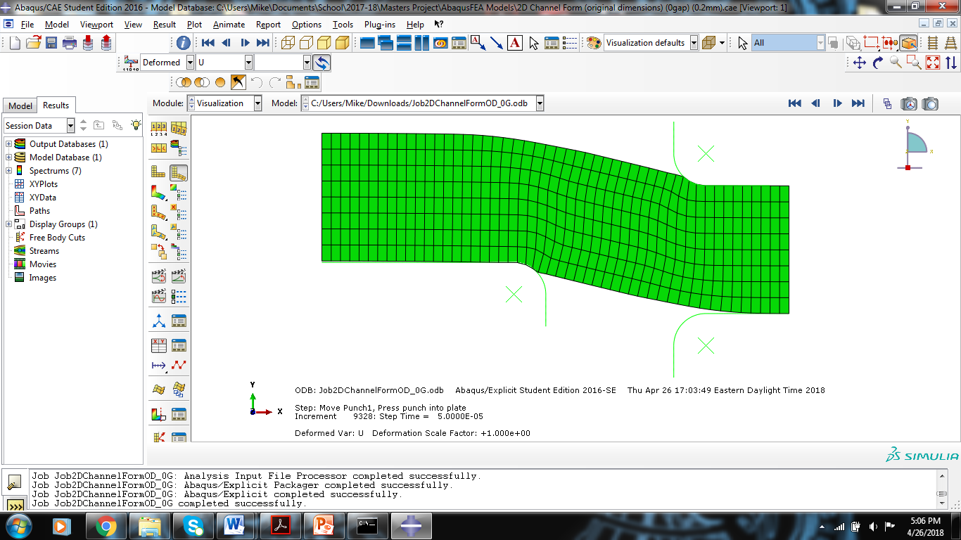
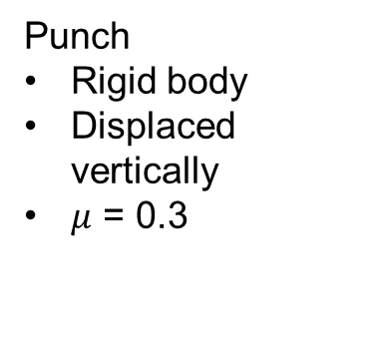
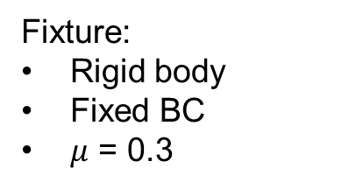
Rib Forming
Initial Foil
Fixture:
Rigid body
Fixed BC
$μ$ = 0.3
Foil:
Thickness: 0.5mm
Fixed BC on left and right sides of foil
Type of elements: CPE4R
700 elements
Dynamic, Explicate
Punch
Rigid body
Displaced vertically
$μ$ = 0.3
Deformed Foil
Form Depth
Modified values:
Bend Radii: 0.25mm
Forming Depth: 0.2mm
Gap: 0.5mm (width of sheet)
Gap

Slide 14
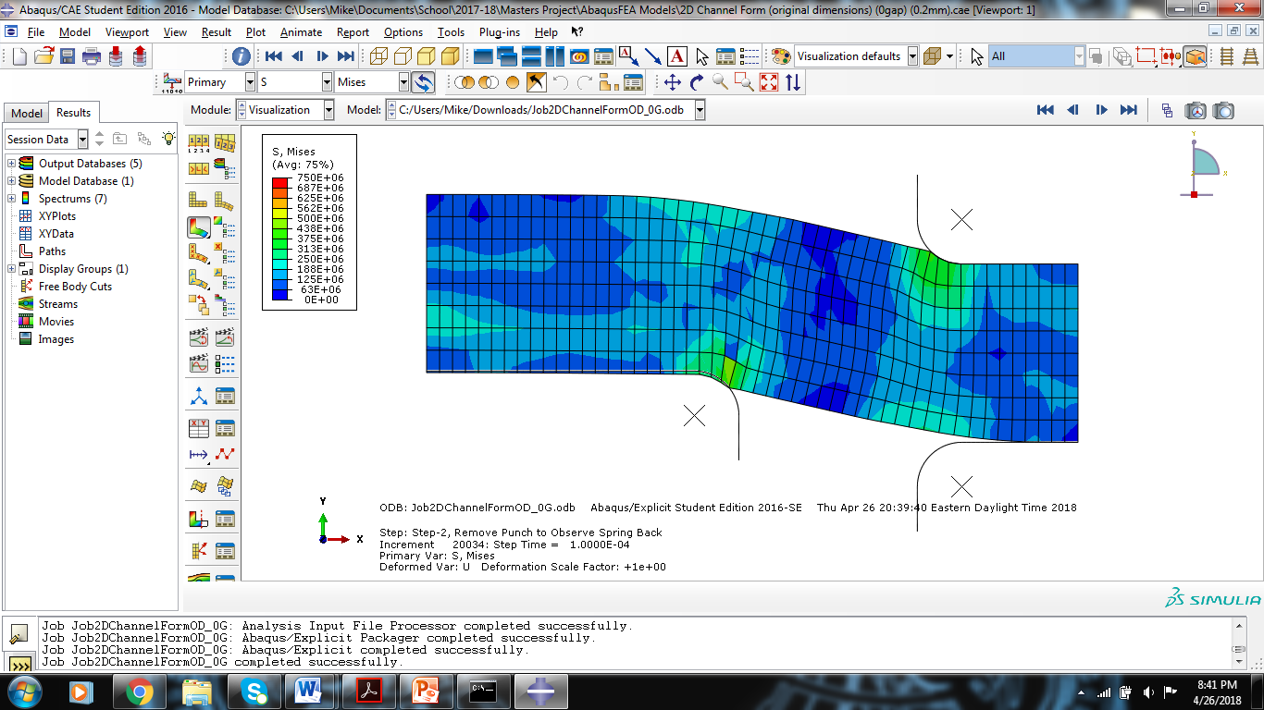
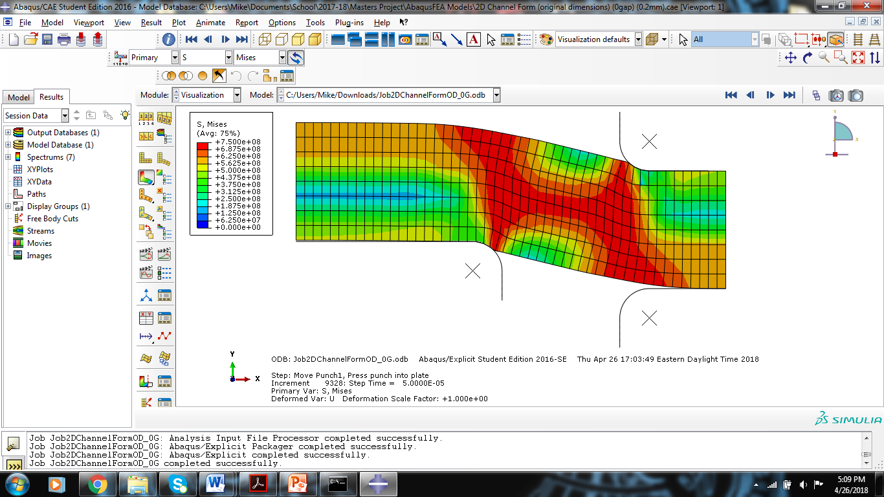
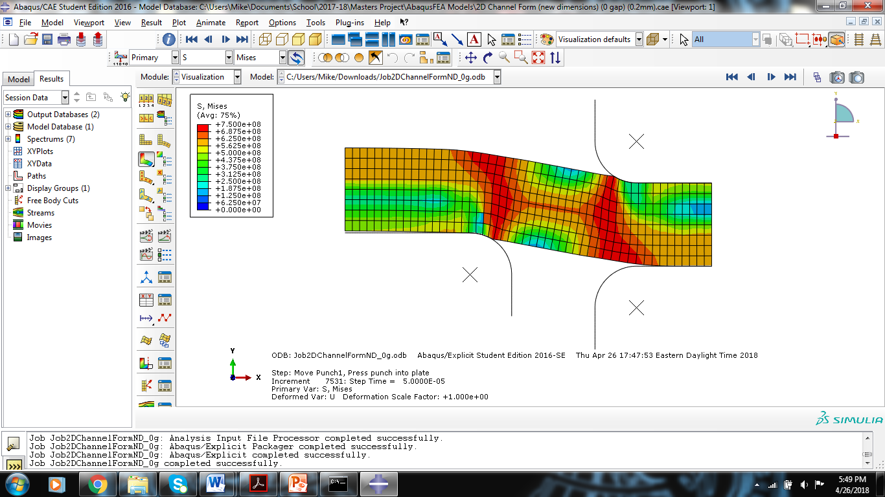
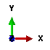
Rib Forming
Von Mises Stress for New and Original Radii, 0.2mm Form Depth and +0% Gap Width
0.125mm Radii
0.25mm Radii
Condition | Max Stress (MPa)
Form Depth, Form Gap | 0.125mm Radii | 0.25mm Radii
0.2mm Depth, 0% Gap | 748.8 | 733.8
0.2mm Depth, 10% Gap | 751.1 | 738.6
0.5mm Depth, 0% Gap | 829.0. | 796.1
0.5mm Depth, 10% Gap | 836.4 | 798.9

Slide 15
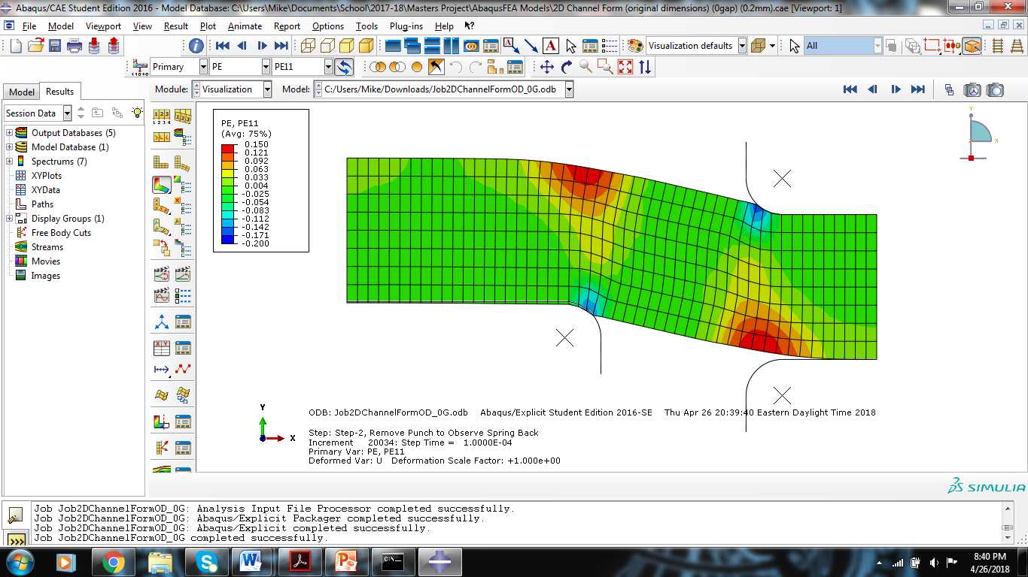
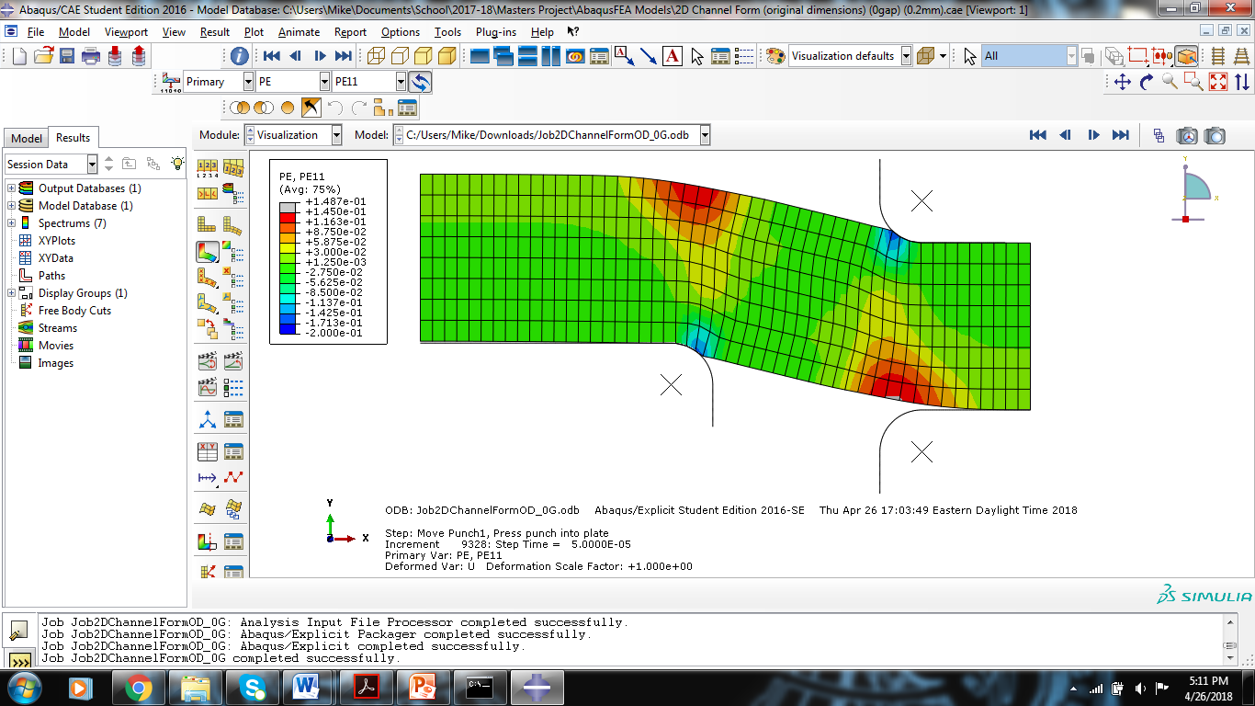
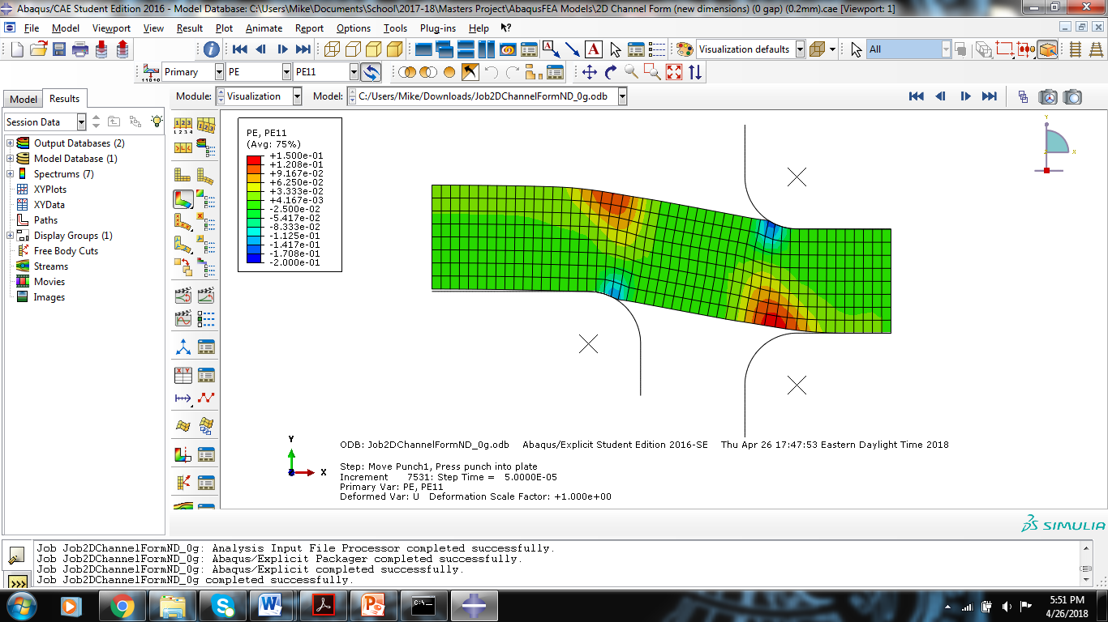
Rib Forming
In-Plane Principal Strain for New and Original Radii
0.2mm Form Depth and +0% Gap Width
0.125mm Radii
0.25mm Radii
Condition | Max Strain
Form Depth, Form Gap | 0.125mm Radii | 0.25mm Radii
0.2mm Depth, 0% Gap | 0.149 | 0.140
0.2mm Depth, 10% Gap | 0.147 | 0.137
0.5mm Depth, 0% Gap | 0.367 | 0.341
0.5mm Depth, 10% Gap | 0.357 | 0.335
Large strain for 0.5mm depth

Slide 16
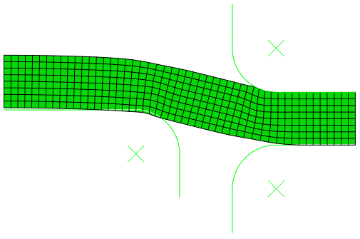
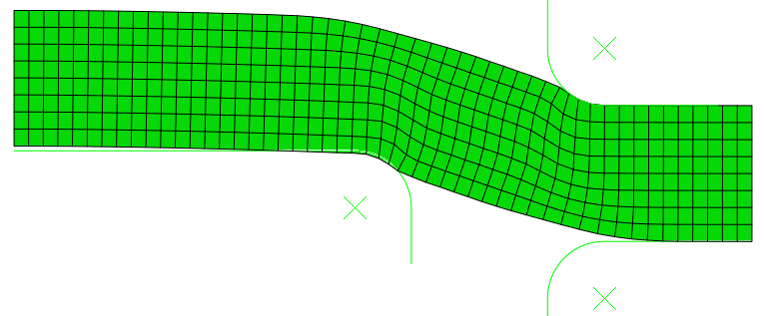
Rib Forming
Springback measured from top left corner of sheet after the interaction between the punch and the sheet is removed
Condition | Springback (mm)
Form Depth, Form Gap | 0.125mm Radii | 0.25mm Radii
0.2mm, 0% | 0.0037 | 0.0194
0.2mm, 10% | 0.0038 | 0.0215
0.5mm, 0% | 0.0065 | 0.0133
0.5mm, 10% | 0.0072 | 0.0143
Sharper radii could benefit springback

Slide 17
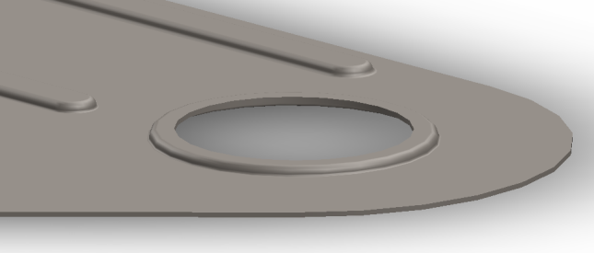
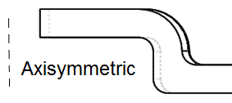
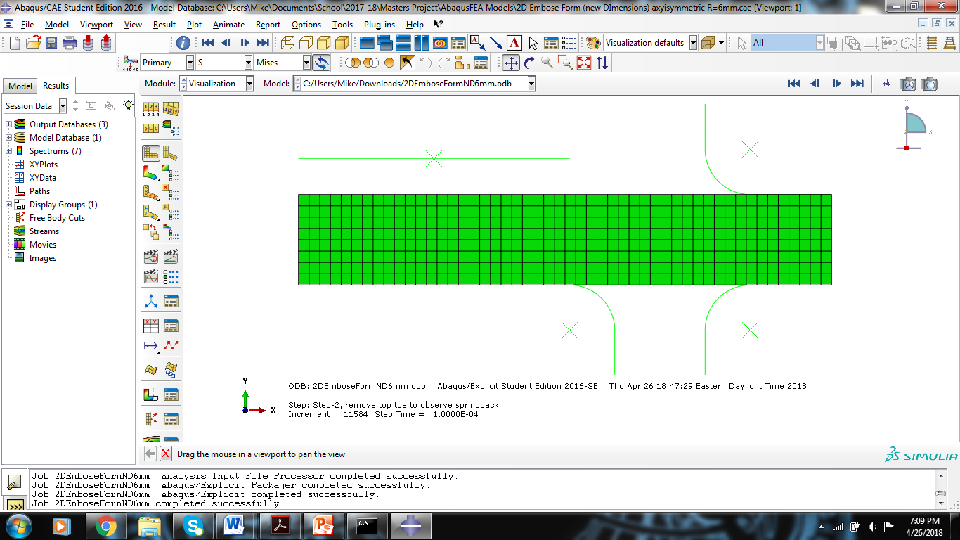
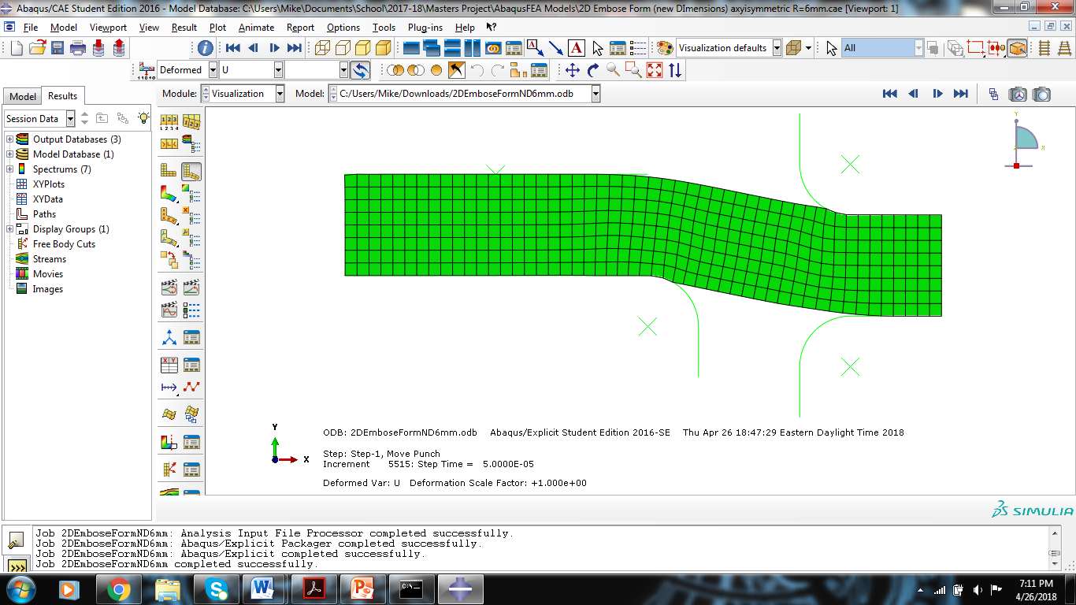

Emboss Forming
Die position based on form depth
Initial Step
Step 1: Deformed sheet to desired depth
Step 2: Remove punch and die to observe springback

Slide 18
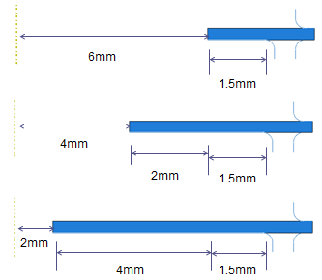
Emboss Forming
0.2mm Depth, 0.25mm Bend Radii, 0% Gap Width, Varied Hole Radius

Slide 19
Emboss Forming
Stress and Strain for 6mm Radii Hole 0.25mm Bend Radii, Varied Form Depth and Gap Width
Condition | Max Stress (MPa)
Form Depth, Form Gap | Step 1 | Step 2
0.2mm Depth, 0% Gap | 723.4 | 569.2
0.2mm Depth, 10% Gap | 722.1 | 464.4
0.5mm Depth, 0% Gap | 789.0 | 567.2
0.5mm Depth, 10% Gap | 784.1 | 632.1
Condition | Max Strain
Form Depth, Form Gap | Step 1 | Step 2
0.2mm Depth, 0% Gap | 0.122 | 0.122
0.2mm Depth, 10% Gap | 0.120 | 0.120
0.5mm Depth, 0% Gap | 0.335 | 0.336
0.5mm Depth, 10% Gap | 0.317 | 0.318
Large strain for 0.5mm depth

Slide 20
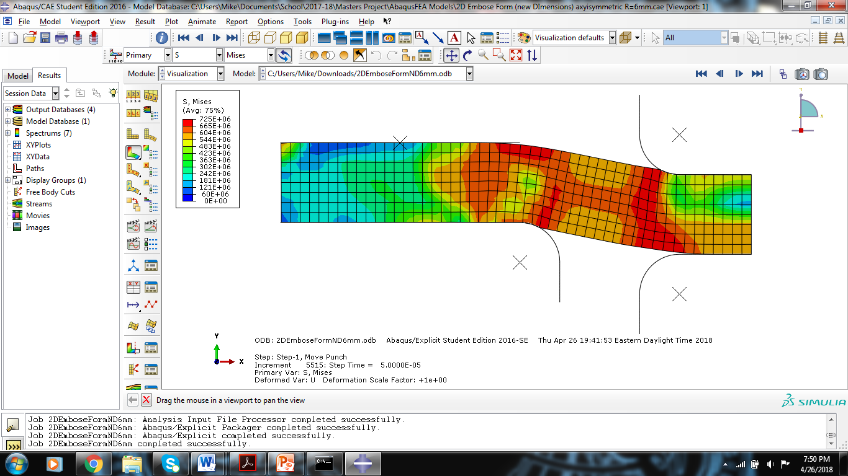

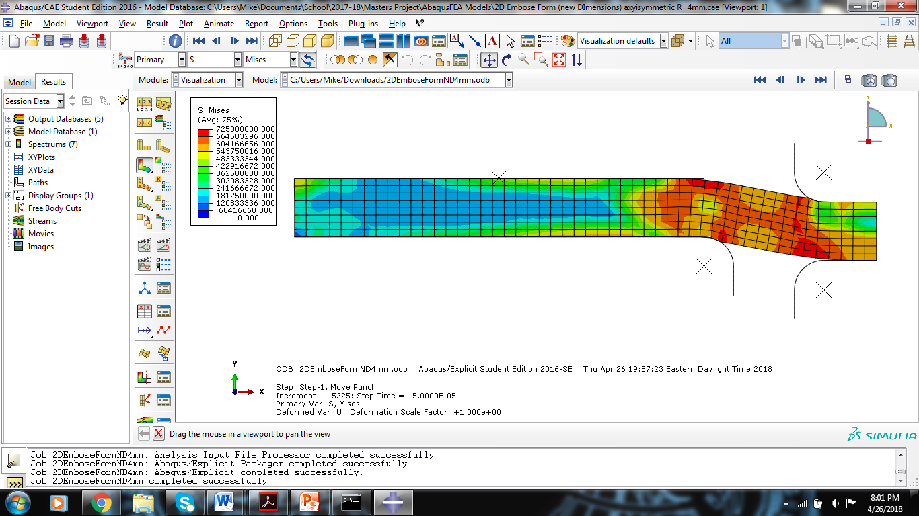
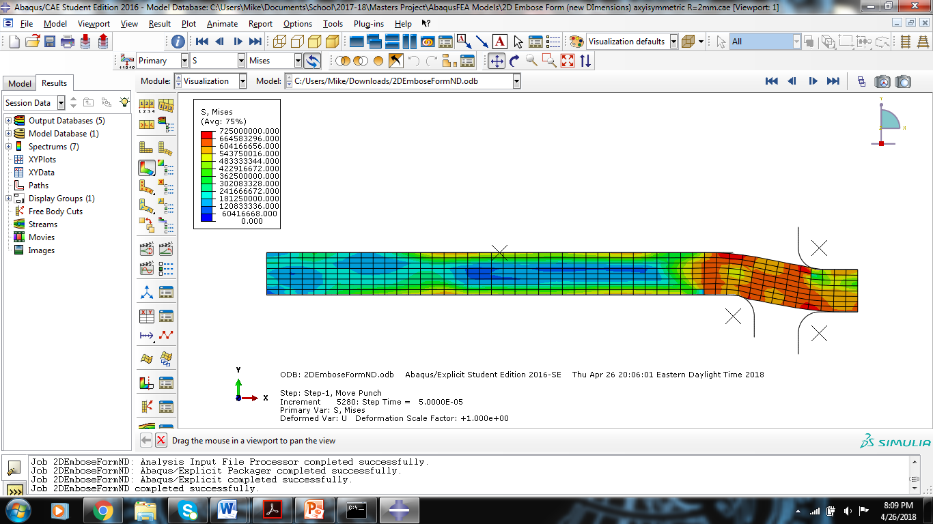
Emboss Forming
Von Mises Stress with Varied Hole Diameter: 0.25mm Radii, 0.2mm Form Depth, 0% Gap
Max Stress (MPa)
6mm
723.4
4mm
713.8
2mm
707.8

Slide 21
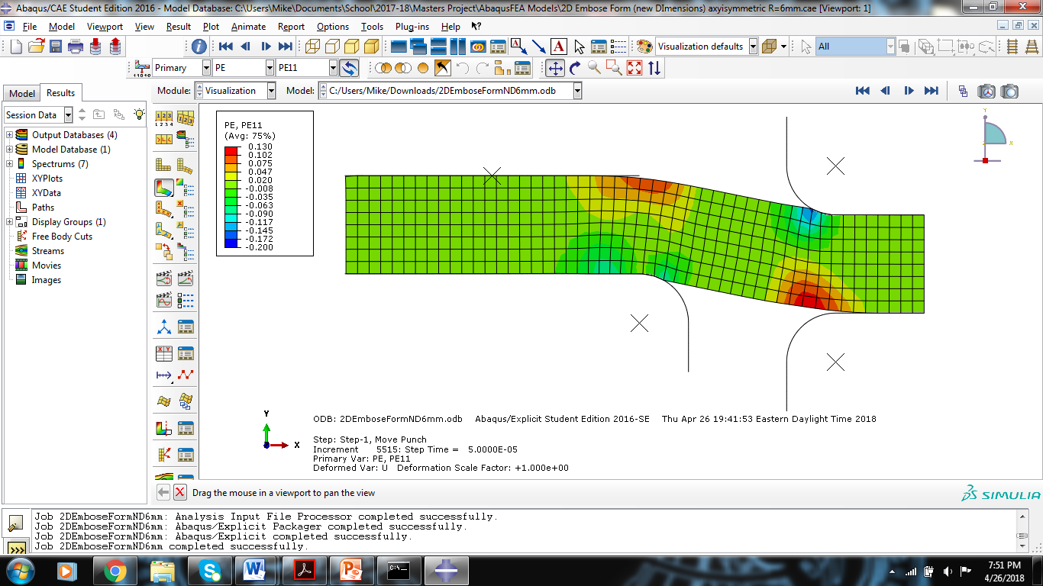

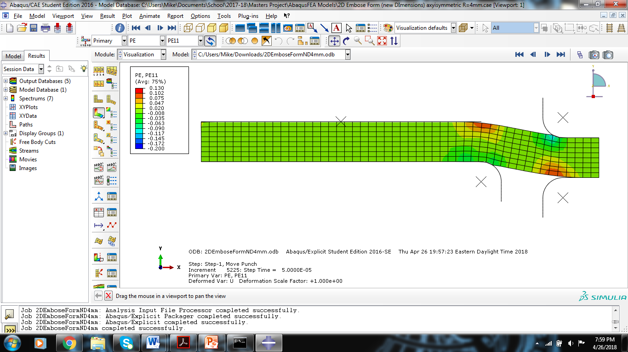
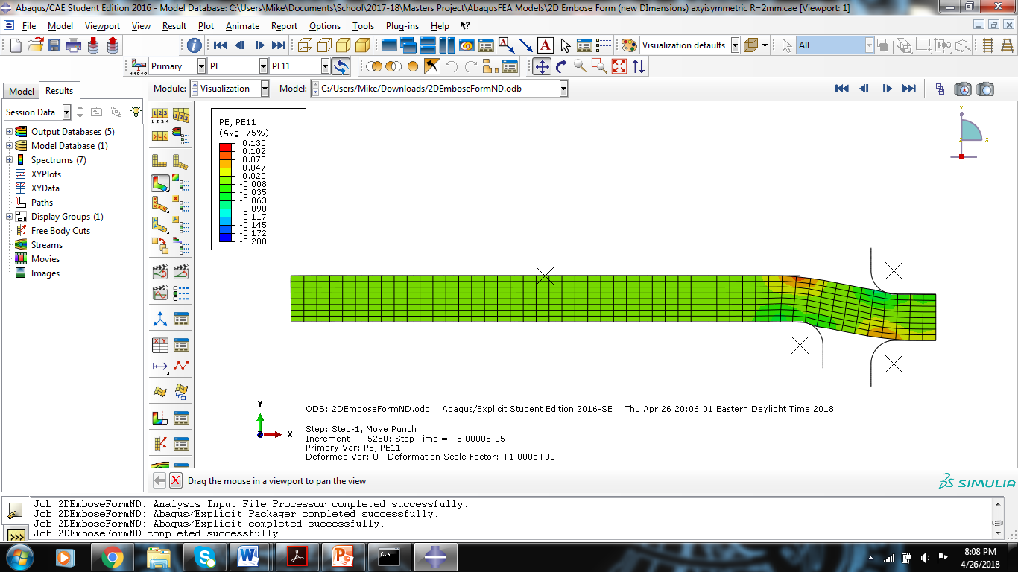
Emboss Forming
Emboss Forming with Varied Hole Diameters 0.25mm Radii, 0.2mm Form Depth, 0% Gap
Max Strain
6mm
0.122
4mm
0.098
2mm
0.086

Slide 22
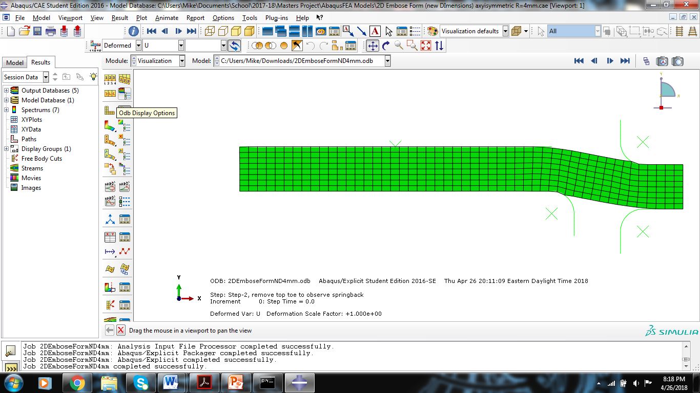
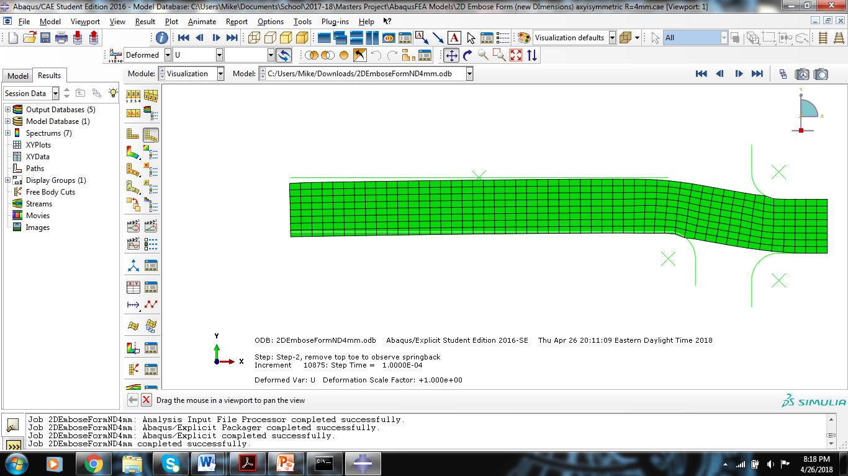
Emboss Forming
Springback Height Change 0.25mm Radii, 0.2mm Depth, 0% Gap
Change in Height (mm)
Measured in positive
Y-direction
Measure springback after
removal of punch and die

Slide 23
Emboss Forming
Springback Height Change 0.25mm Radii, 0.2mm Depth, 0% Gap
 | Springback (mm)
 | 2mm Radii | 4mm Radii | 6mm Radii
Vertical Direction (Y) | 0.0853 | 0.146 | 0.1622
Larger hole could benefit springback

Slide 24
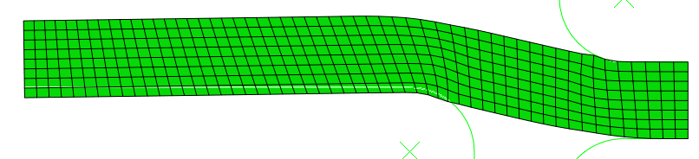
Emboss Forming
Tolerance on Flat Emboss Surface
Height change across surface
 | Change in Height (mm)
 | 2mm Radii | 4mm Radii | 6mm Radii
Vertical Direction (Y) | 0.0942 | 0.0298 | 0.0172
Larger hole could benefit springback

Slide 25
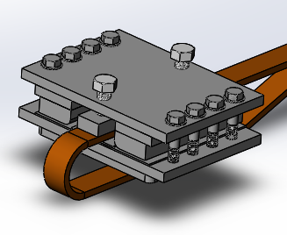
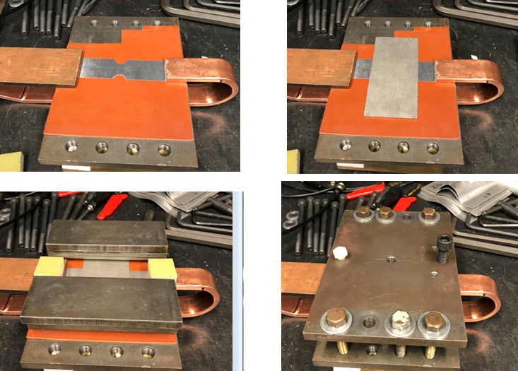
VFA Experimental Set-Up
12 kW Magneform Machine
400 kA
7 kV
Vaporizing Foil: 5754-Aluminum: 127x25.4x0.07mm dog-bone strips
Copper bars: Highly conductive 101 Copper
Workpiece: 1100-Aluminum: 76x127x0.5mm sheets
Copper Bars
Workpiece
Vaporizing Foil
G10 Insulation
PDV hole in A2 steel plate

Slide 26
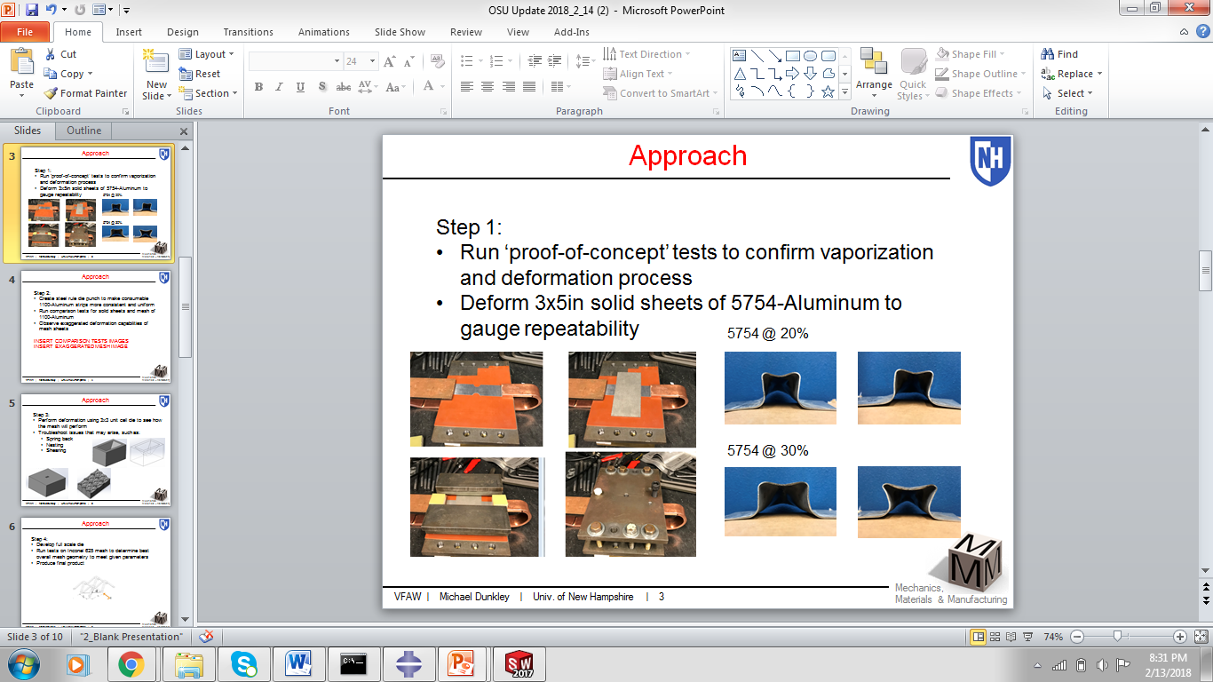
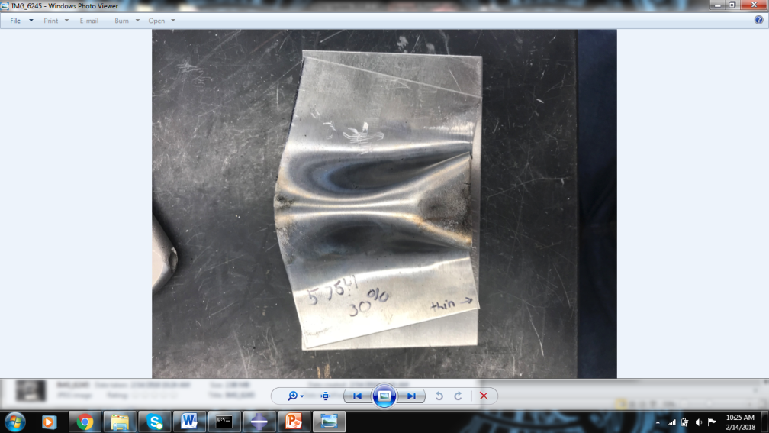
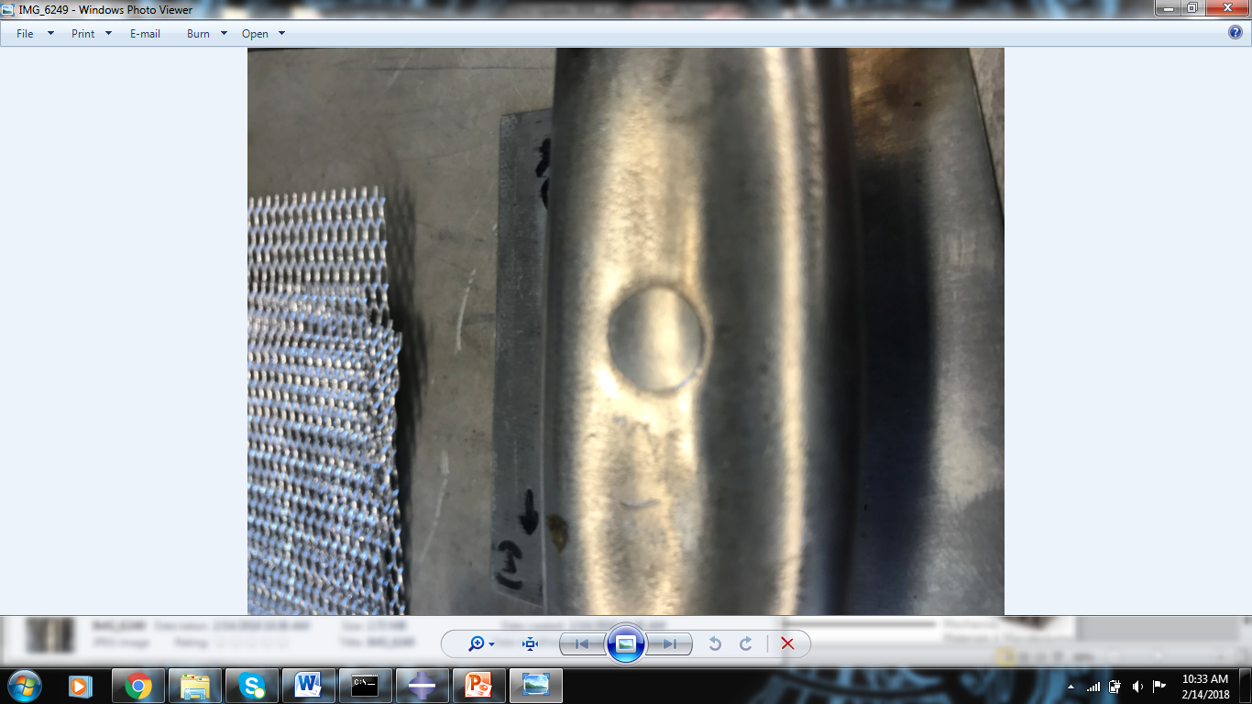
VFA Experimental Results
Draw in of Material
Coining of PDV hole into sheet
25mm
54mm
Height limited by distance in set up

Slide 27
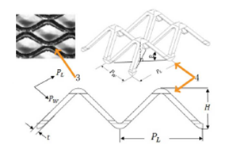
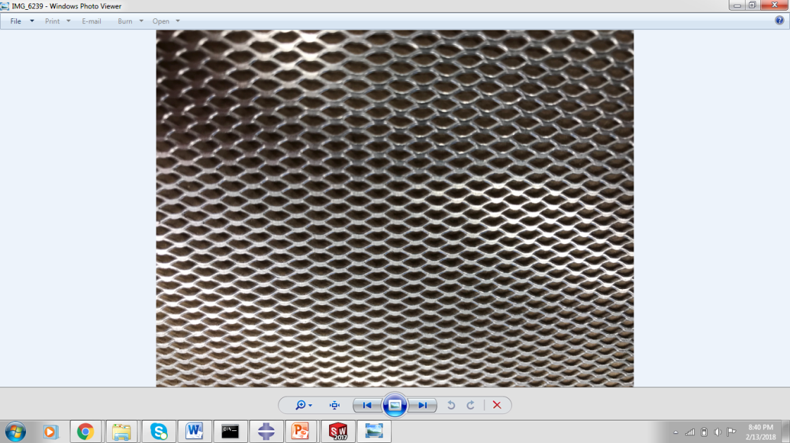
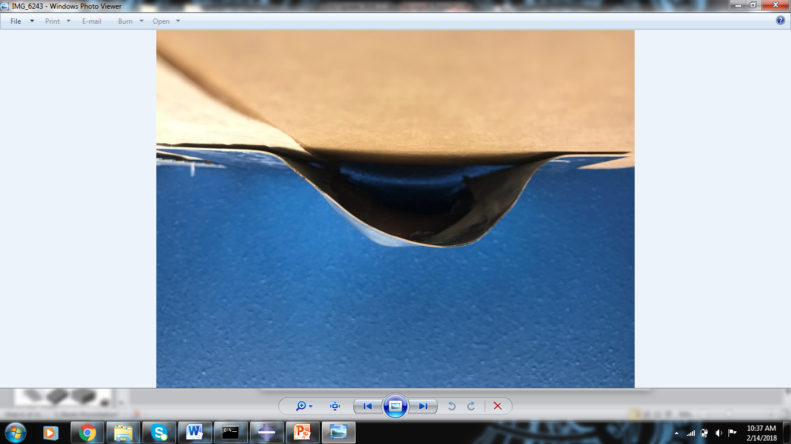
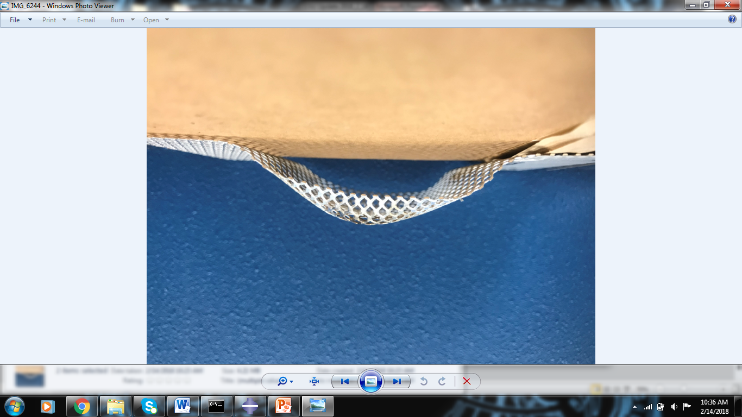
VFA Experimental Results
Compare deformation of solid sheet vs mesh
24mm
20mm
Deformation of mesh and solid sheet of 1100-Al, 0.5mm thick at 7%

Slide 28
Future Work
Perform uni-axial, plane strain and equi-biaxial tension, as well as high rate Kolsky bar test, on Inconel 625
Run Abaqus simulation with whole lamina geometry to assess all failure modes including wrinkling
Conduct experimental trials to assess consistency and repeatability
Compare theoretical and experimental results for both

Slide 29
Questions

Slide 30
References
A. Vivek, G.A. Taber, J.R. Johnson, S.T. Woodward, Glenn S. Daehn, “Electrically driven plasma via vaporization of metallic conductors: A tool for impulse metal working”, Journal of Materials Processing Technology 213(2013) 1311-1326
A. Vivek, S.R. Hanser, Glenn S. Daehn, “High strain rate metalworking with vaporizing foil actuator: Control of flyer velocities by varying input energy and foil thickness”, Review of Scientific Instruments 85, 075101 (2014)
B. Paul. “Low-Cost Waste Heat Recovery Using ‘Half-Array’ Microchannel Heat Exchangers”. Oregon State University, lecture
Special Metals, ‘INCONEL Alloy 625’, specialmetals.com

Slide 31
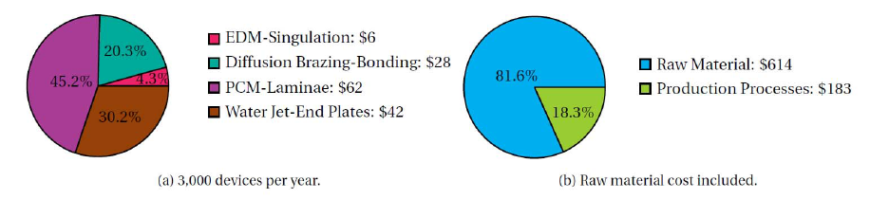
Appendix
Cost Comparison

Slide 32
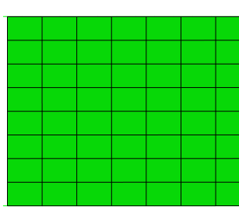


Emboss Forming
Magnified view of how the formed emboss will experience springback with the removal of the top die and punch
r
Springback leading to angled emboss feature and varied hole diameter
Die
Nodal Displacement
Center of emboss hole
Punch

